Slide 1
Spreadsheet Project:
AstroSage Analysis

Slide 2

Agenda
Problem Statement
Data Description
Objective Key Metrics and Visualizations
Subjective Question for Insights

Slide 3
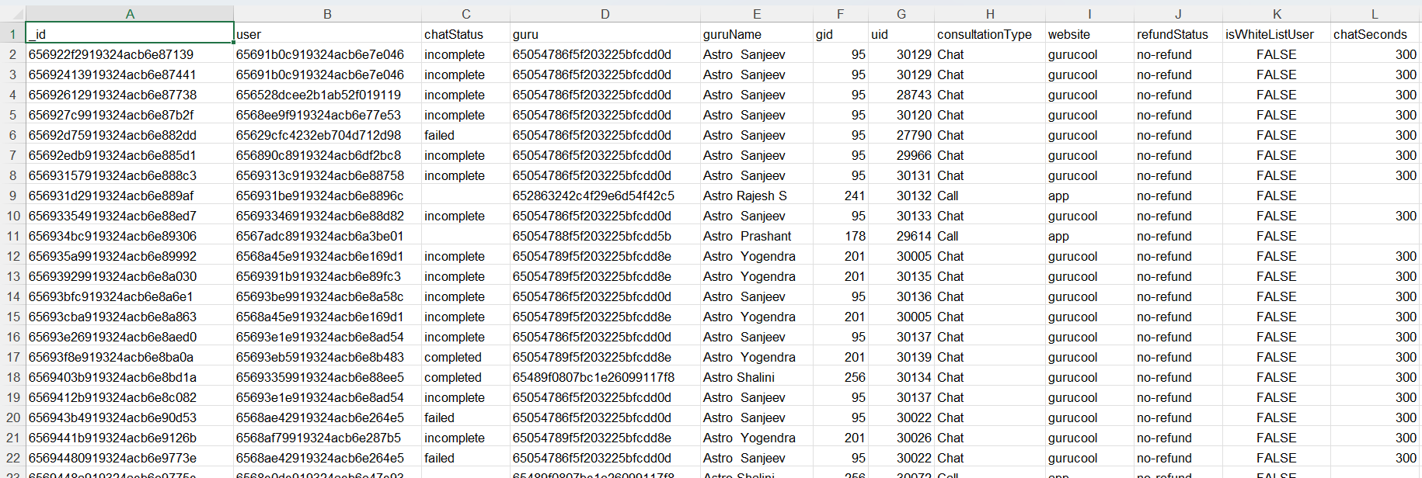
Problem Statement
AstroSage has received a 1 crore investment and aims to optimize its call center operations. The goal is to determine how to allocate this investment to maximize operational efficiency, customer satisfaction, and profitability. The analysis will consider historical call data, performance metrics, and market trends to make informed decisions.

Slide 4
The image above displays details about AstroSage Performance, including:
_id: Unique identifier for each record.
user: User ID associated with the record.
chatStatus: Status of the chat (e.g., incomplete, failed, completed).
guru: Unique identifier for the guru.
guruName: Name of the guru.
gid: Guru ID.
uid: User ID.
consultation Type: Type of consultation (e.g., Chat, Call).
website: Source of the consultation (e.g., gurucool).
Refund Status: Indicates if the session is refundable or not (e.g., no-refund).
is WhiteList User: Boolean indicating if the user is whitelisted.
chat Seconds: Duration of the chat in seconds.
queue: Boolean indicating if the session was queued.
FreeCall: Boolean indicating if the call was free.
Free Chat: Boolean indicating if the chat was free.
CreatedAT: Original creation date and time.
updatedAt: Original update date and time.
__v: Version key.

Slide 5
The image above displays details about AstroSage Performance, including:
statementEntryId: Identifier for the statement entry.
chatStartTime: Start time of the chat.
chatEndTime: End time of the chat.
timeDuration: Undefined, some technical data as per app. (Don’t use it as the duration of chat/call)
callChannel: Channel used for the call.
calIvrType: IVR type used during the call.
callStatus: Status of the call.
CallSid: Unique identifier for the call session.
amount: Amount charged for the session.
astrologerCallStatus: Status of the astrologer during the call.
astrologerOnCallDuration: Duration of the astrologer's call.
astrologersEarnings: Earnings of the astrologer from the session.
netAmount: Net amount after deductions.
region: Region of the user.
userCallStatus: Status of the user's call.
userOnCallDuration: Duration of the user's call.
rating: Rating assigned based on the session's status.

Slide 6

Use this Link for copying and then manipulating the dataset.

Slide 7
Submission
There is a series of tasks/questions mentioned ahead in the Project, in order to guide the candidates to have suggestions, insights for the management.
Imagine you have to present the submitted PPT file to the senior management using which you are giving the suggestions as per the requirement with the reasoning/help of dashboard, visualizations or tables you’ve created.
The submission Zip file should consist of the following three documents:
Excel File (.xlsx) (consisting of dashboard)
Document File (.docx) (consisting of Answers and suggestions for Objective and subjective questions)
Presentation File (.pptx) (consisting of the presentation which you want to present to the management)

Slide 8
Tasks
…Tasks in order to come up with expansion suggestions

Slide 9
Objective Questions
What is the total no. of tables present in the data?
What is the total no. of attributes present in the data?
The data consists of some inconsistent and missing values so ensure that the data used for further analysis is cleaned.
What is the change in daily call volume day by day and also find the average of daily call volume?
Which months experienced the highest and lowest call volumes?
What is the total operational cost for that month?
What is the average number of calls handled per agent per day?
How many repeat callers are there, and what percentage of total calls do they represent?

Slide 10
Objective Questions (Cont..)
What is the total sales generated by the call centre for each product category?
How many calls were made for each user ID and guru ID?
What is the correlation between call duration and customer satisfaction?
Which guru have the highest and lowest customer satisfaction scores?
What is the average customer satisfaction score by month?
How many categorical columns are there in the data? [Search about categorical and continuous data, and try to answer this question]

Slide 11
In order to answer the next data analysis questions you will have to create Dashboards and visualizations (Can choose few pivot tables as well ).
For answering these questions you need to properly analyze the data through summarization, dashboard and visualizations to give the insights. Back your suggestions/insights with proper reasoning considering the data.

Slide 12
Data Analysis and Visualizations (Subjective Question)
Should the investment be used to hire more agents, improve training programs, or upgrade call center technology?
What are the potential risks of each investment option (hiring, training, technology upgrades), and how can they be mitigated?
Name the chart/spreadsheet function you will use for solving the problem?
How does AstroSage call center performance compare to that of AstroGuru in terms of average call volume, customer satisfaction, and agent performance?
Will you use any aggregation function or a visualization here to solve the problem?
How can the call center improve its handling of peak call periods to ensure high customer satisfaction? Mention the functionality which you will use for giving the suggestions, will it be any aggregated function or a visualization?

Slide 13
Data Analysis and Visualizations
Based on historical data, what strategic initiatives should be prioritized to improve overall efficiency and customer satisfaction?
What can be the key factors contributing to high customer satisfaction scores, and how can these be leveraged to improve overall performance?
What is the basis for the suggestions? And mention how did you decide if the satisfaction score affect the ratings?
How should the call center balance the workload among agents to ensure optimal performance and avoid burnout?
Mention your approach and spreadsheet function for the answer?
What new technologies or tools could be implemented to enhance call center operations and customer service?

Slide 14
What metrics should be included in the final dashboard to provide a comprehensive view of call center performance and guide investment decisions?
How would you allocate a 1 crore rupee investment to optimize operational efficiency, enhance customer satisfaction, and boost profitability, and what analysis-based recommendations would you offer to support this?
Ensure that you put the slicers for choosing the country and year in order to observe the dashboard since the management will be having a long discussion which can go for weeks.
Note: The dashboard would be more interactive and user-friendly, allowing management to explore data in detail and make informed decisions.

Slide 15
SUBMISSION DEMONSTRATION
Refer to the video released in the batch
One can use this link in order to understand the sample
approaches for each section of the project.

Slide 16
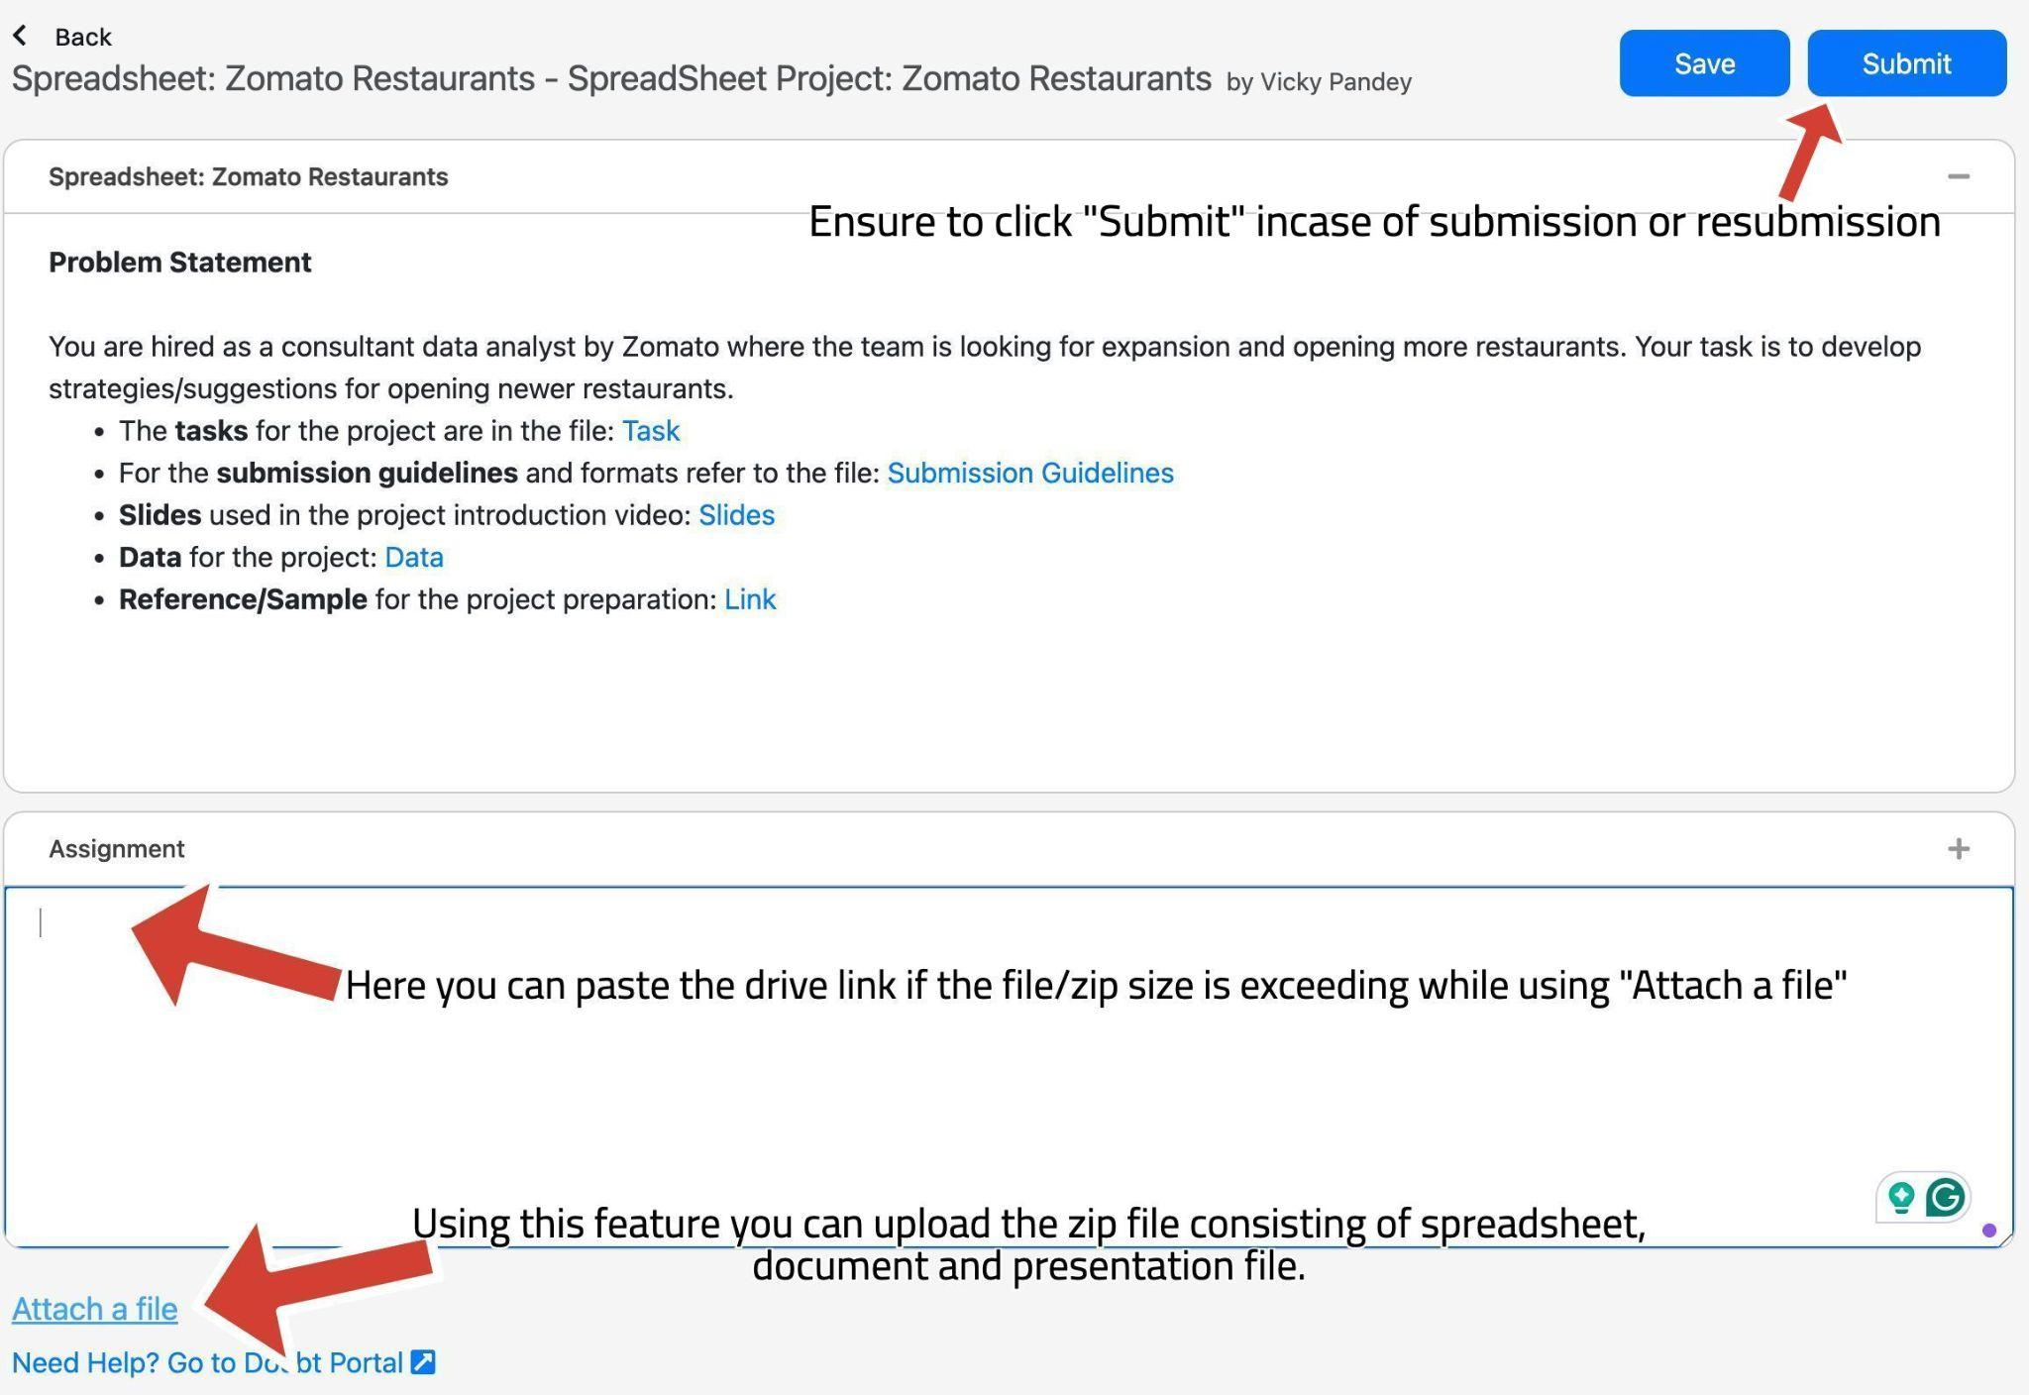
Submission UI
The submission UI can be changed a bit from the video, kindly refer here.
Look at the arrows and the comments to get familiar with the UI while submission and uploading the files on the platform. There is a space to paste the drive link and upload the zip file.

Slide 17
SUBMISSION FLOW
The candidates are supposed to have the first submission for the project within the 10-day deadline
After the submission, candidates will receive feedback on their project, which they are supposed to incorporate and re-submit within 1 week of feedback.
All the candidates are supposed to get a total of 8 marks to be prioritized in placements since is is necessary in Placements.
The re-submissions after 3 weeks of launch in the batch will be de-prioritised for evaluations.
Candidates will have to give the reason for their delay, in order to make sure that team picks up their evaluation.
This will create backlogs as the project for next module will also be releasing around the same time.
So make sure to submit the project (with the requirements) within timeline.
Candidates have to submit the zip of Excel, Docx and Presentation files.

Slide 18
GUIDELINES:
Ensure to submit the project within the deadline.
TA support won’t be answering any direct questions regarding project, they can help in the approach but not with the exact soln.
Plagiarism will be checked during evaluation.
Queries regarding submission should be asked to success champions.
Candidates must score >=8 out of 10 in order to be picked for referrals.

Slide 19
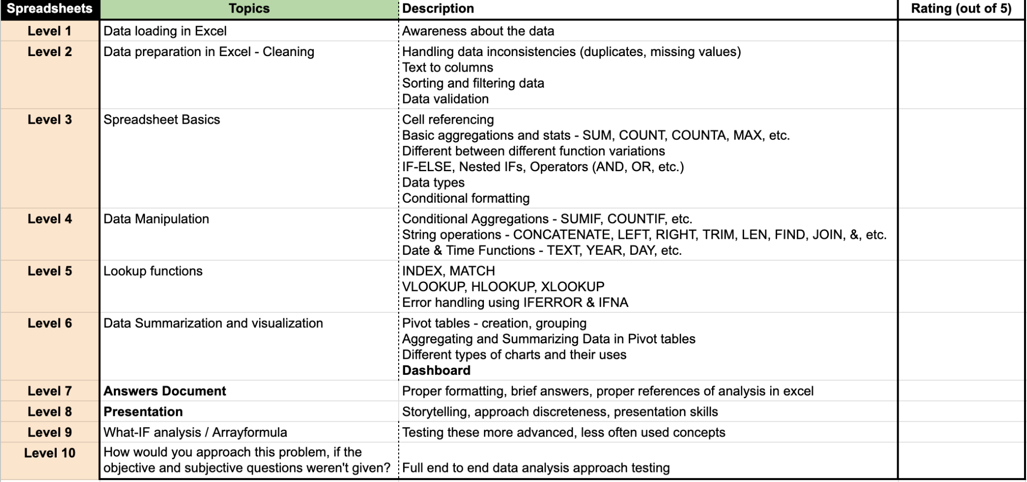
EVALUATION
The projects will be evaluated on 10 levels (Each learner will receive a detailed feedback).
On each level, learners will get a rating out of 5 and if the rating is smaller than 4, he won’t be considered as passed at that level.
Learners have to get >=4 (or passed) in at least 8 levels to get >=8 as the final rating in the project.
In the final feedback, only the final feedback out of 10 will be considered.

Slide 20


